Slide 1
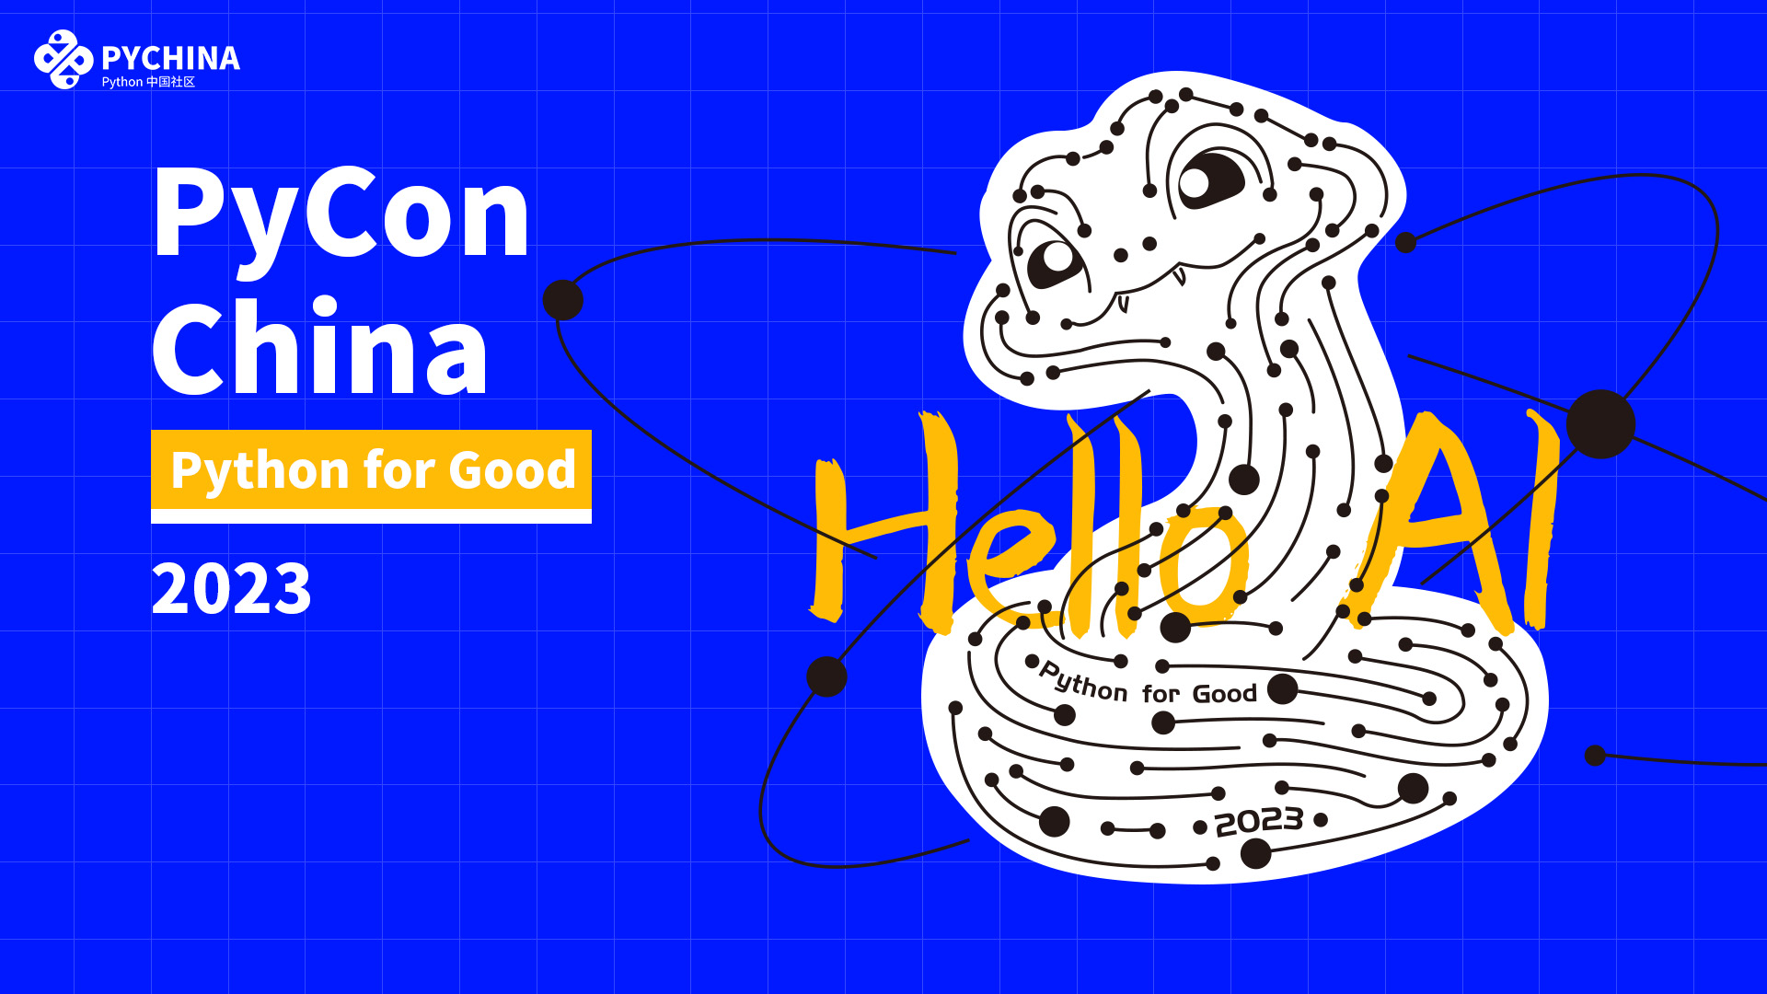

Slide 2
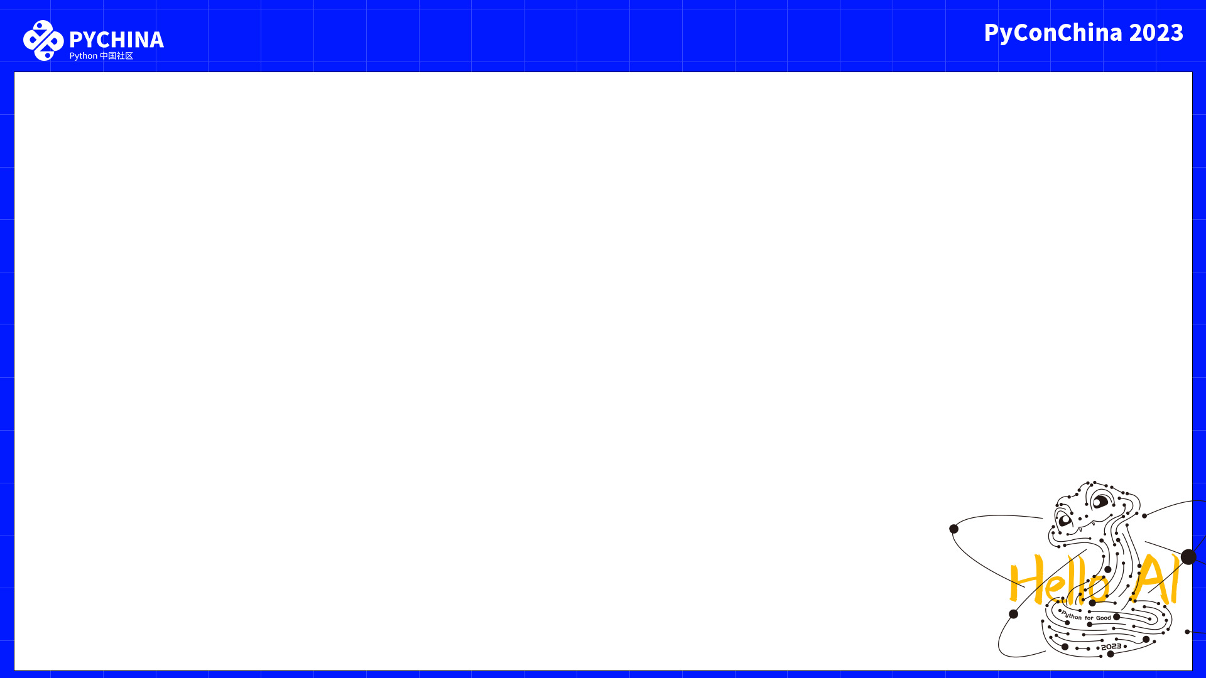
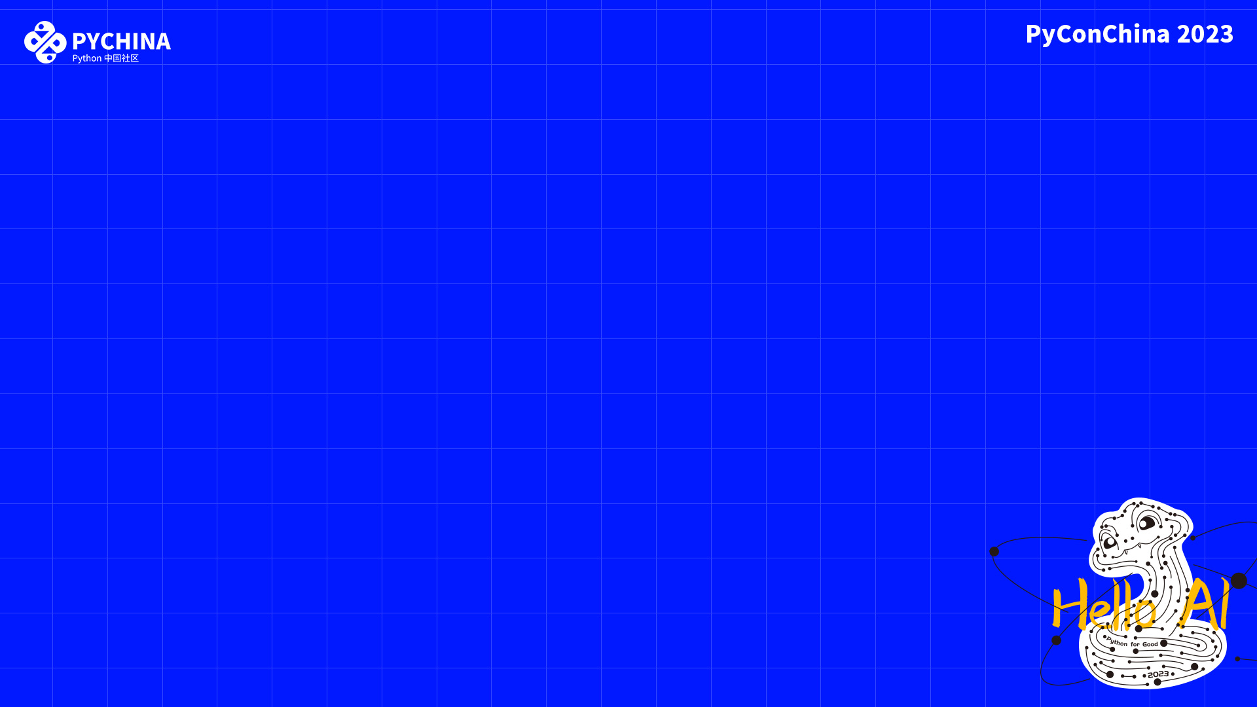
Accessing MongoDB
Sub-Documents
Through Proxy Objects
Jonathan Lindstrom
Headwaters Entrepreneurs Pte Ltd

Slide 3
Agenda
SQL vs NoSQL Databases
CRUD
Mongo documents
  Dictionaries
  Custom objects
Mongo subdocuments
  Dictionaries
  Lists
  Polymorphic objects

Slide 4
Python
The universe is collection of objects
dict, list, tuple, set, string, int, float, True, False, None
Duck typing

Slide 5
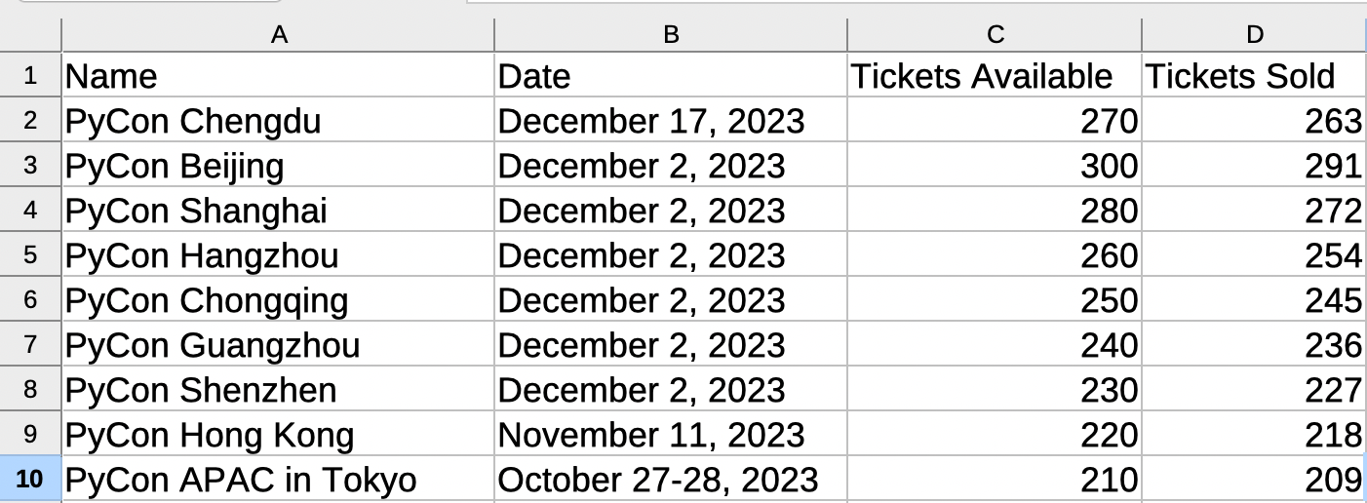
SQL Databases
The universe is a series of connected tables

Slide 6
NoSQL Databases
The universe is a list of dictionaries
events = [
{
'name' : 'PyCon Chengdu',
'date' : 'December 17, 2023',
'ticketTotal' : 270,
'ticketSold' : 263,
},
{
'name' : 'PyCon Beijing',
'date' : 'December 2, 2023’,
'ticketTotal' : 300,
'ticketSold' : 291,
},
]

Slide 7
MongoDB
Collections are lists of dictionary objects
Interface inspired by JavaScript
Query language uses a dictionary to filter objects
Every item is assigned a universally unique 12-byte ObjectID

Slide 8
MongoDB
Not quite Python:
BSON format only stores primary types
Dictionary keys must be strings
No date objects, only datetime
datetime objects are stored in UTC
datetime objects store milliseconds (0.001),
not microseconds (0.000001)

Slide 9
CRUD
Create | insert_one() find_one_and_replace( upsert=True )
Read | find_one() find()
Update | find_one_and_replace() find_one_and_update()
Delete | find_one_and_delete()

Slide 10
Demonstration Application
Simple Flask application to manage ticket sales for events
Support multiple events
Support multiple ticket types per event (VIP, regular, student, etc)
Track ticket sales
An Interative Approach…
QR code for sample app at the end of the talk

Slide 11
Iteration 1
Track events and total tickets only, not individual sales
Use dict object as returned from find_one()
Issues
Unable to attach custom functions to result values
No easy way to look up an event

Slide 12
Iteration 2
Create UserDict subclass “Event” to wrap MongoDB return
Wrap existing find() and find_one() functions to return our class
Create id() and loadById() to make lookups easier
Protect data from being overwritten with safe save() function
Add custom functions to support our application like isSoldOut()
Issues
Not a general solution

Slide 13
Iteration 3
Refactor into generalized MongoUserDict to handle any MongoDB collection

Slide 14
Iteration 4
Implement a TicketType object that refers back to an Event object
  SQL databases would use a separate table with a join
  NoSQL just uses a list or dictionary of dictionaries within the parent
Considerations
How do we keep the TicketType object connected to the parent?
How do we avoid multiple dictionaries floating around?
How do we update MongoDB after a change?

Slide 15
Dictionary Proxy
Leverage duck-typing to create a dictionary-like object
Actual dictionary still lives in the parent object
Dunder functions and others direct calls back to the underlying object
Design Bonus
Unique IDs for subdocuments
Load parent and subdocument together

Slide 16
Iteration 5
Log ticket sales with a Ticket object
  Use a list of dictionaries within the parent object
Design Bonus
Only evaluate the list position when the list changes

Slide 17
Iteration 6
Provide support for custom benefits for each ticket type
  Implement polymorphic subdocument objects based on data in the subdocument

Slide 18
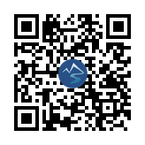
Sample Code
https://headwaters.com.sg/link/586d8be9

